Slide 1
TSRTC- STUDENT PASS APPLICATION- Guide for Students Upto SSC

Slide 2
This Guide is intended to instruct the applicant with required details while applying for pass.
Students are Only allowed to Collect Passes at the Counters selected while applying Online.
Filling all the Fields in the application is Mandatory.
Payment can be made Offline (at counters during the time of collecting pass)
Applicant Should enter his/her
Date of Birth (in DD/MM/YYYY)

Slide 3
Student should enter valid
Mobile number
Upload Photo (JPEG format, size < 50 KB)
Select Route
City route/city free
District Route/District Free
Greater passes
Applicant is given a choice to select the centre.
Date of visit is shown next to counter while applying

Slide 4
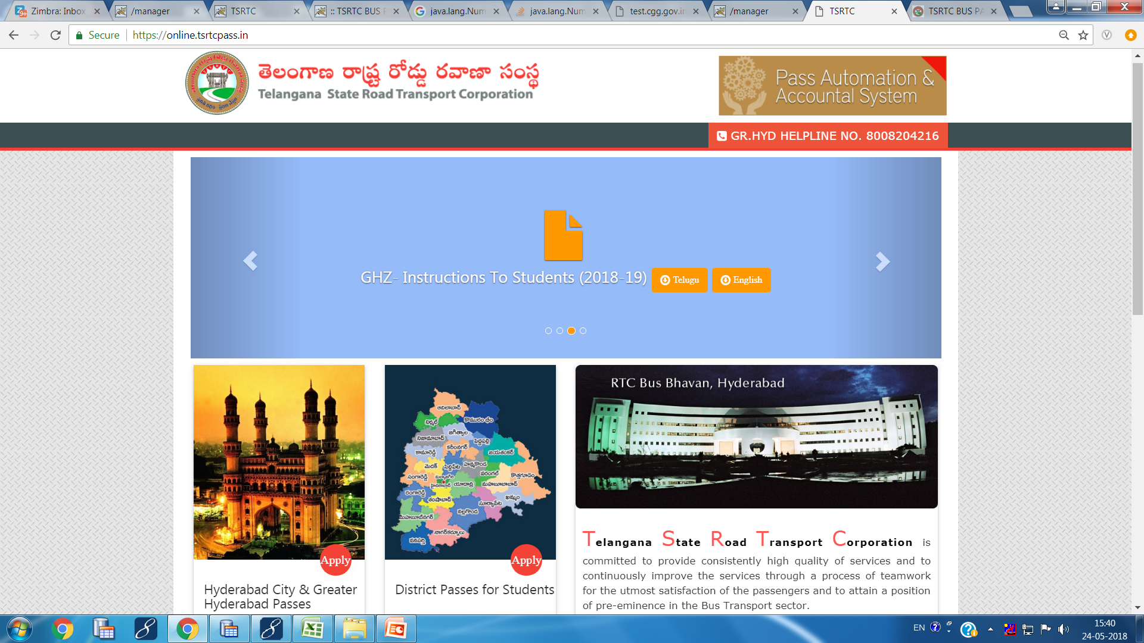
https://online.tsrtcpass.in
Navigation to website
Direct Link

Slide 5
Click here Student Passes for HYD and surrounding District areas
Select for areas OTHER THAN HYDERABAD

Slide 6
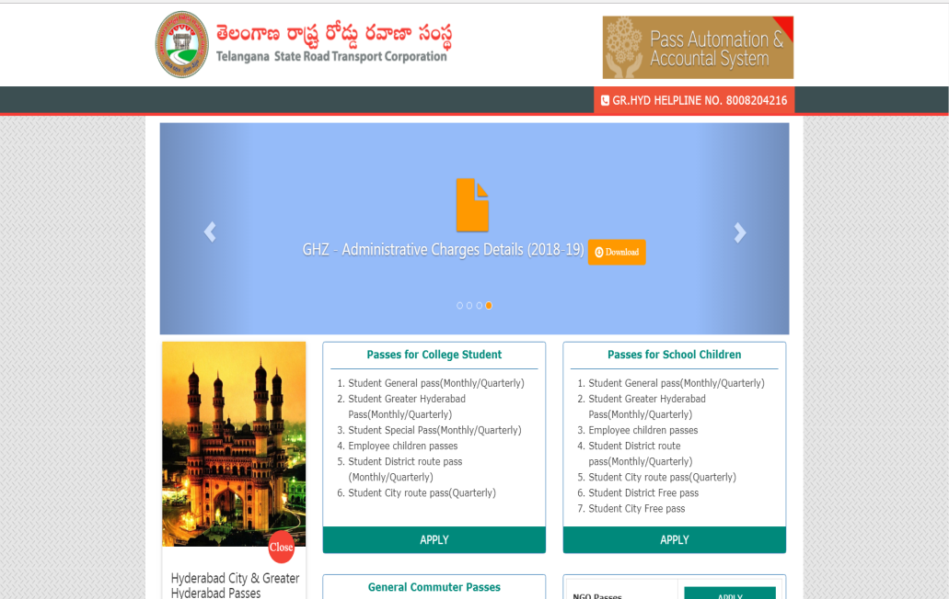
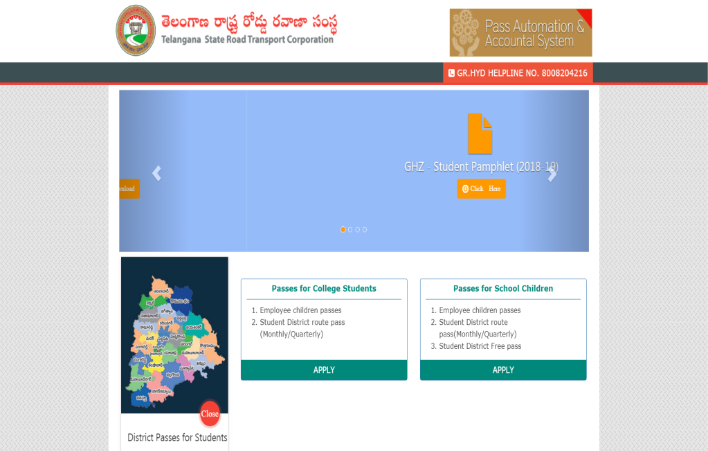
Pass selection screens
Hyderabad & Surrounding areas
Districts Other than HYD

Slide 7
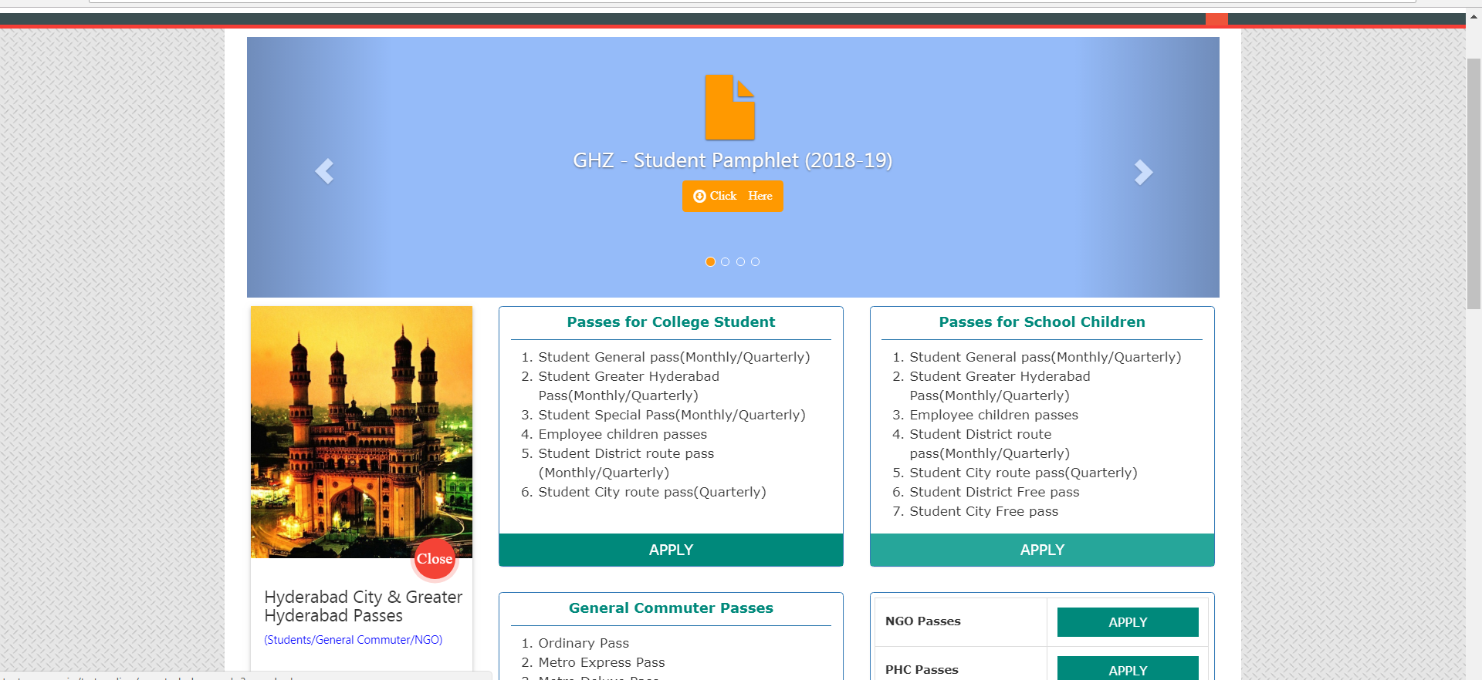
Click here to Apply

Slide 8
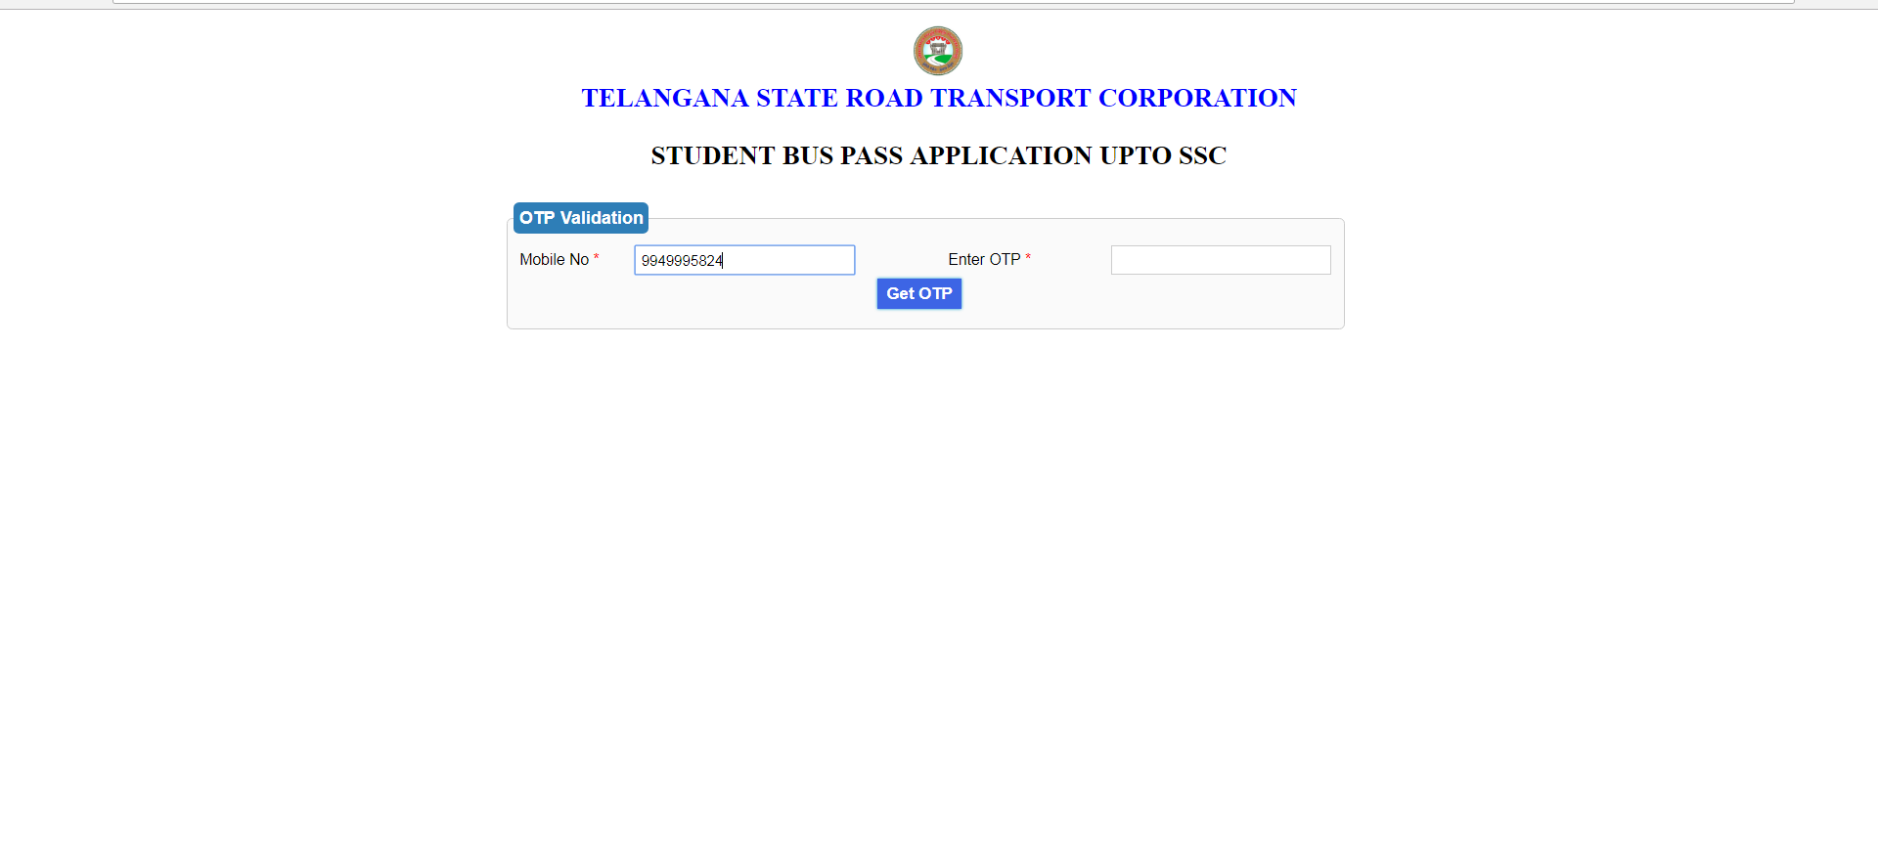
Click here to generate OTP

Slide 9
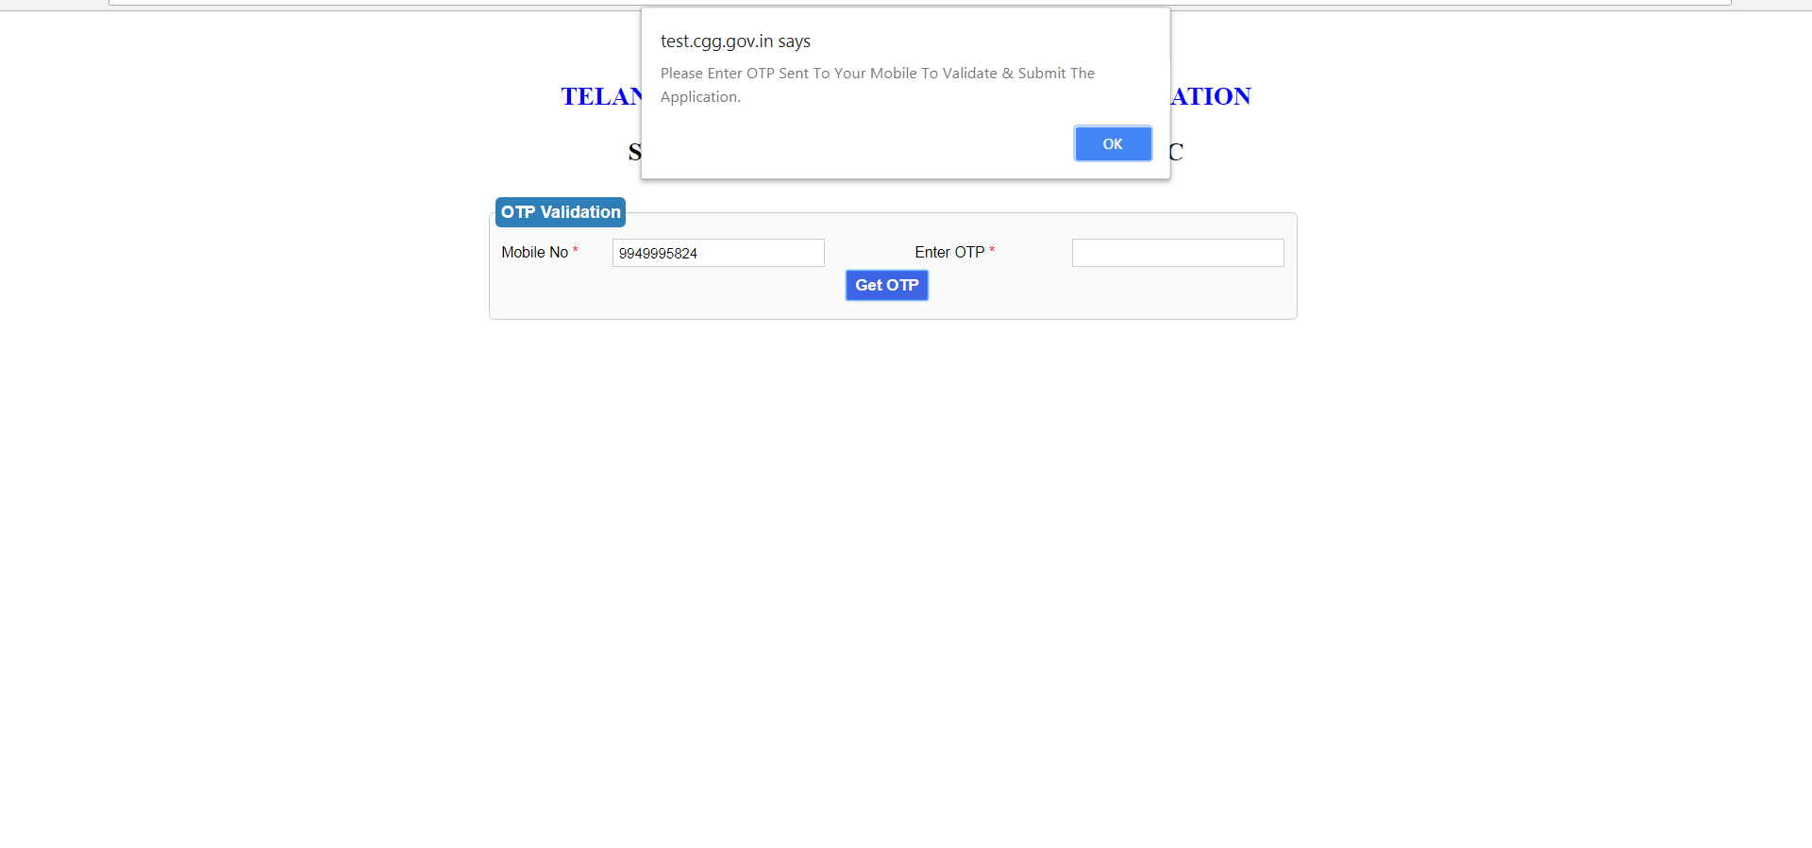

Slide 10
Click on Validate OTP
Enter OTP sent to your mobile here

Slide 11
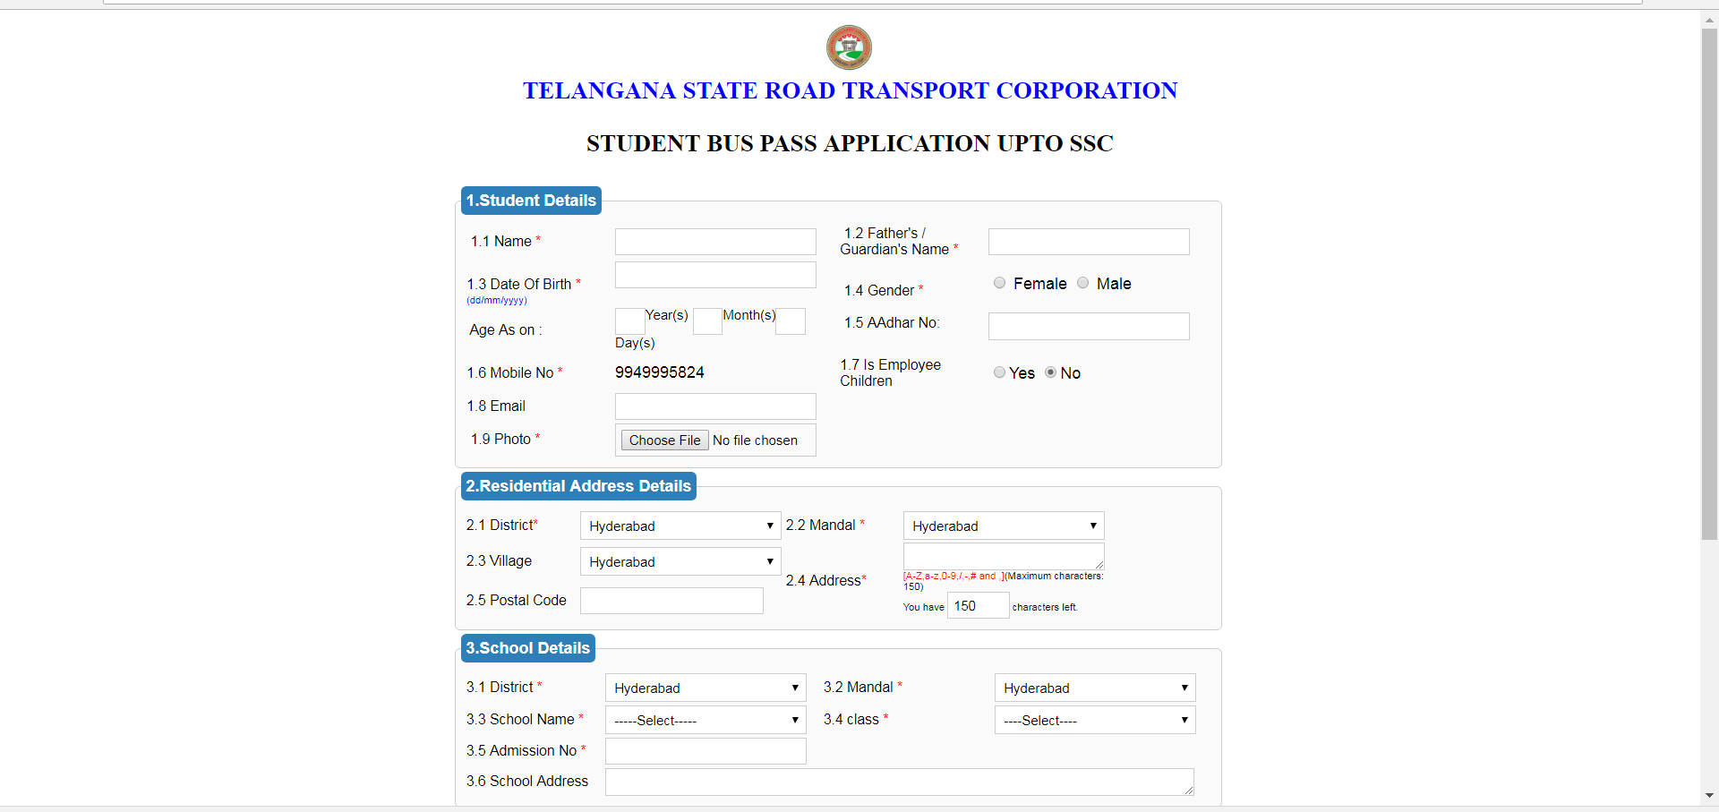

Slide 12
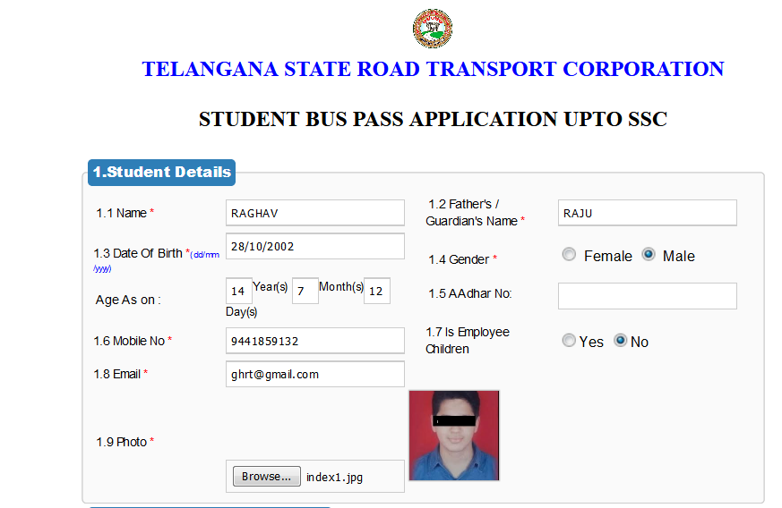
Fill the valid details and upload photo

Slide 13
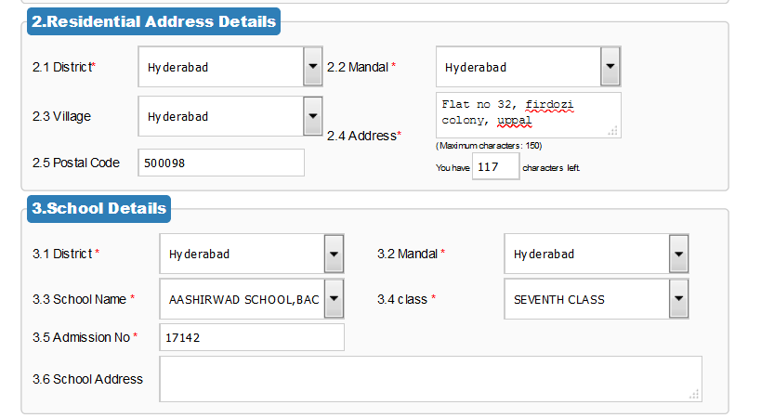
If the school name is not populated in the list, it means the school did not pay its admin charges to RTC.
Hence Pass cannot be issued for those school students.

Slide 14
Institutions and Routes are preloaded
Select the Institution, Class,
Enter Admission Number
Route details
Select the counter closest to you to collect ID/PASS card (visit Date will be displayed next to counter for collection of pass).
Select pass Type(student General monthly/Student Greater pass Monthly)
Payment:
Payment can be made using online or at counter (during collecting your pass)
Mode of delivery of student pass will be done at selected counter only.

Slide 15
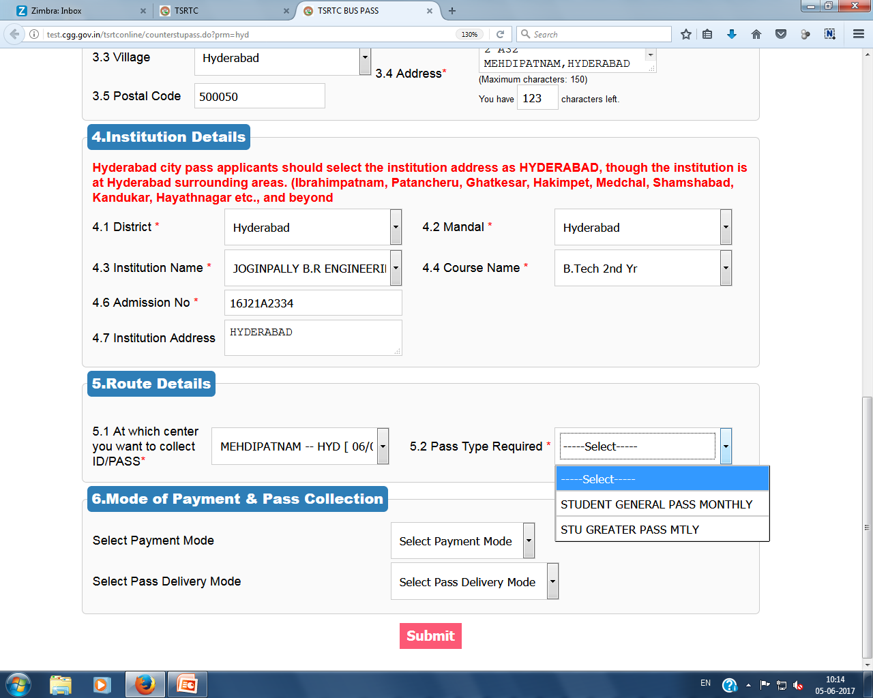

Slide 16
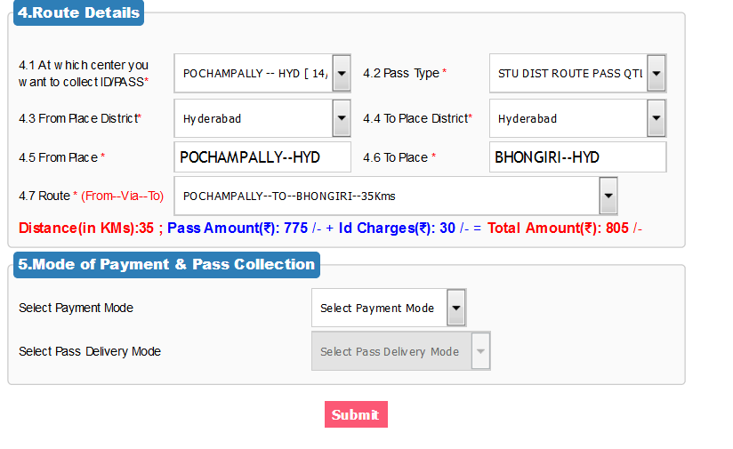
If Route is not Populated in the drop down list, please forward the details to : ghzbuspasstsrtc@gmail.com
Your application will not be submitted if route is not selected.

Slide 17
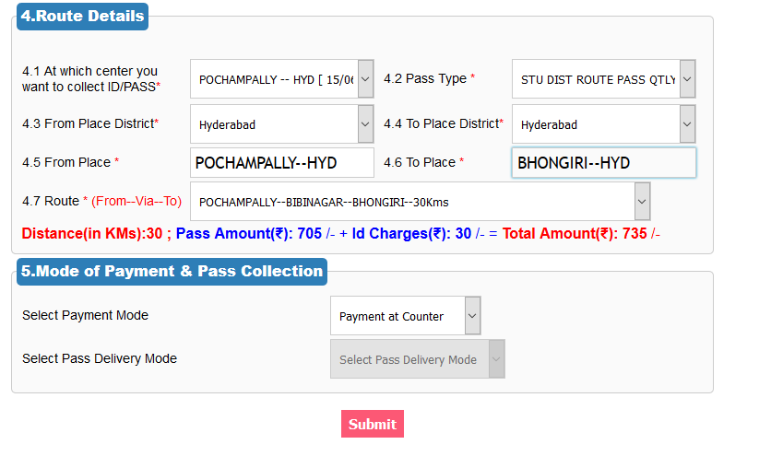
Mode of payment is at counter and can be made using Cash or Credit/Debit cards.
Candidates are instructed to purchase the pass immediately after ID card is issued.

Slide 18
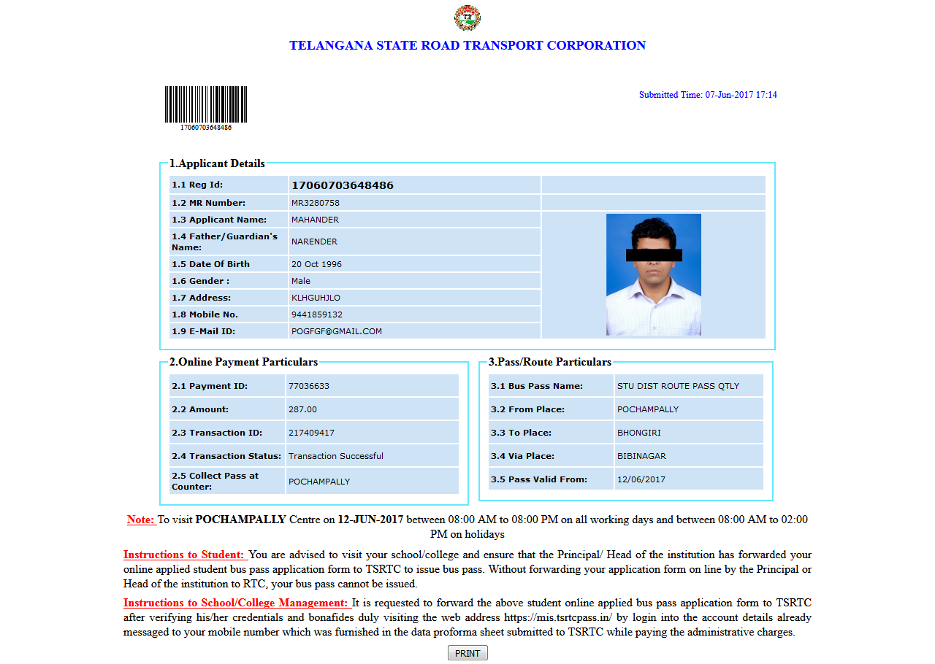

Slide 19
Now your application is submitted successfully, please go to your college or school and request your HM/PRINCIPAL/HOI to forward your application through RTC login provided to them.
IF YOUR INSTITUTION DOESN'T FORWARD THE APPLICATION TO RTC, COUNTER OPERATOR CANNOT VIEW YOUR APPLICATION.
Read the Instructions Carefully before you go to RTC counter to collect your pass.

Slide 20
To approach the Opted Bus counter on the selected date to obtain your bus pass ensure certification from the principal/HOI on the online applied registration acknowledgement receipt.
In case of Employee children passes, employee declaration Original & employee ID photocopy are to be enclosed.

